Slide 1
👋 Hello gentlemen, In this presentation, I will be introducing EDR, EDR components, and its deployment.

Slide 2
Key Objectives:
1. What is Endpoint Detection and Response (EDR)?
2. EDR components
3. Installing SQL server express edition 2022 on Window Server
4. Installing SSMS (SQL Server Management Studio) on Window server
5. Installing and configuring Kaspersky Security Center 15.1 (KSC)
6. Adding Next EDR optimum free trial license key to KSC
7. Installing Kaspersky network agent on end-point devices
8. Understanding KSC 15.1 policies and configuring

Slide 3
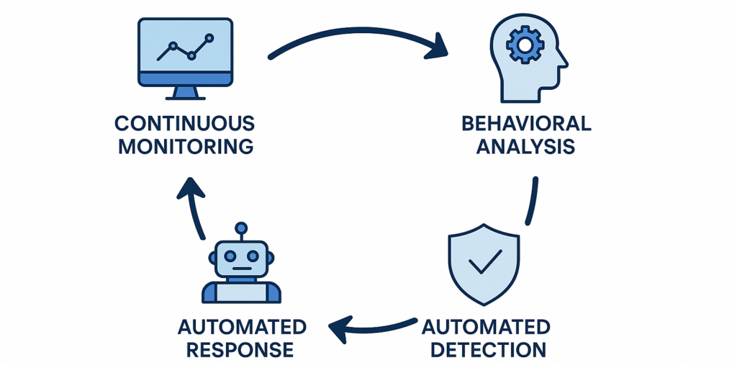
1. What is Endpoint Detection and Response (EDR)?
EDR is an endpoint security solution that continuously monitors end-user devices to detect and respond to cyber threats like ransomware and malware.

Slide 4
2. EDR components
The following are the core components of EDR
Endpoint Agent which is installed on each endpoint to monitor system activity and detect suspicious behavior such as process creation, file changes, registry modifications, and network connections.
Dashboard/Console is a central management sever that receives telemetry from endpoints, and allows administrators to investigate threats and perform actions.
Database that keeps endpoint telemetry, alerts, incidents, and historical data required for threat investigation and reporting.

Slide 5
Detection Engine that analyzes collected endpoint data using signatures, behavioral analysis and machine learning to identify malicious activity.
Response Engine that enables containment(stop) and remediation(to correct) actions on affected endpoints such as terminating processes, quarantining files, isolating hosts, and blocking.
Threat Intelligence which provides information on known malicious hashes, IPs, domains, and attacker techniques to enrich detections and improve accuracy.

Slide 6
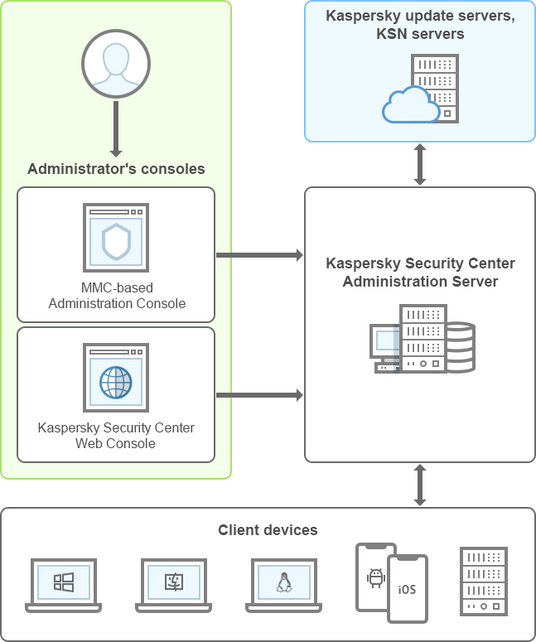
components of KSC and their interaction

Slide 7
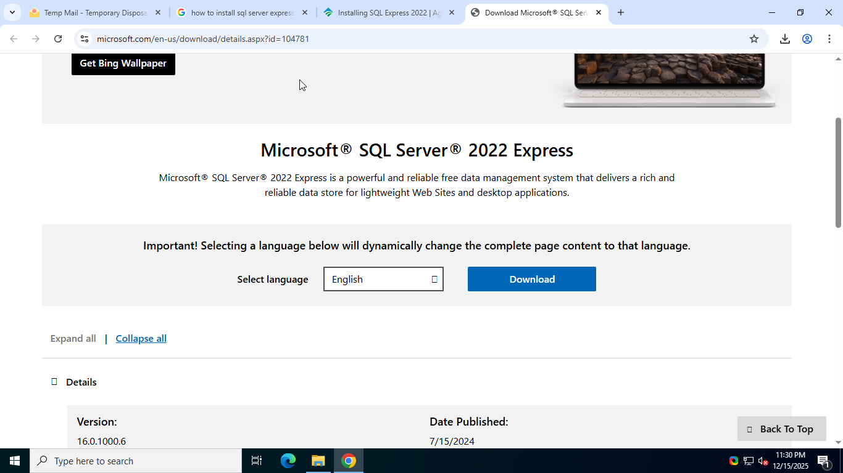
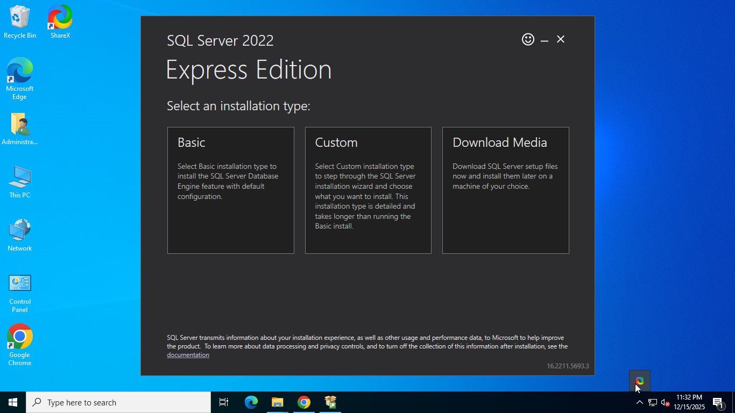
3. Installing SQL server express edition 2022
Microsoft SQL Server express edition 2022 is a free, feature rich editions of SQL Server that is ideal for learning, developing and small server applications.
To download SQL Express edition 2022 click on the below link https://www.microsoft.com/en-us/download/details.aspx?id=104781
click Download
Select Basic

Slide 8
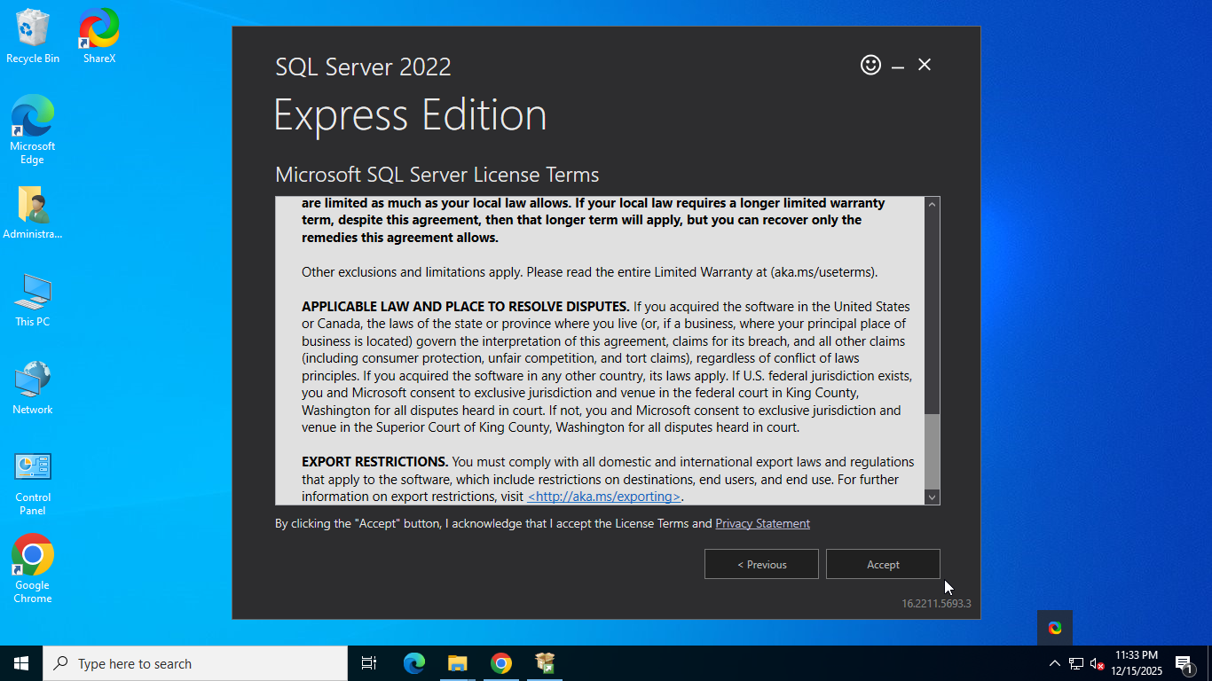
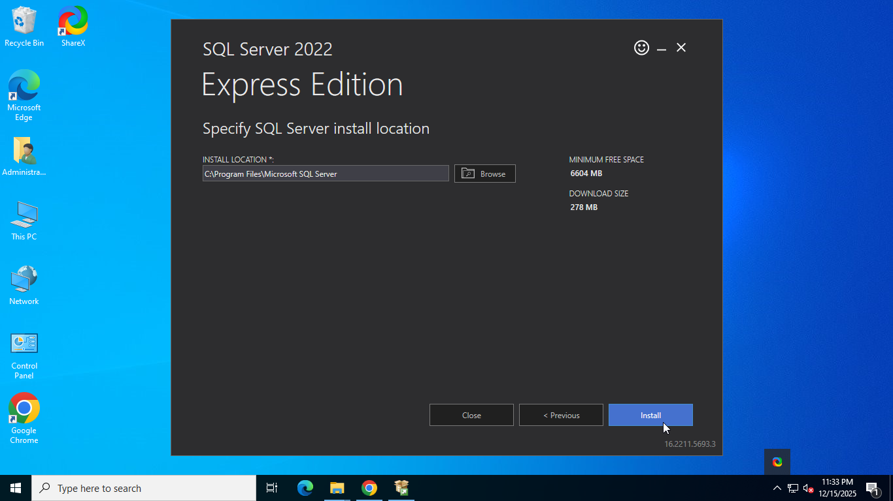
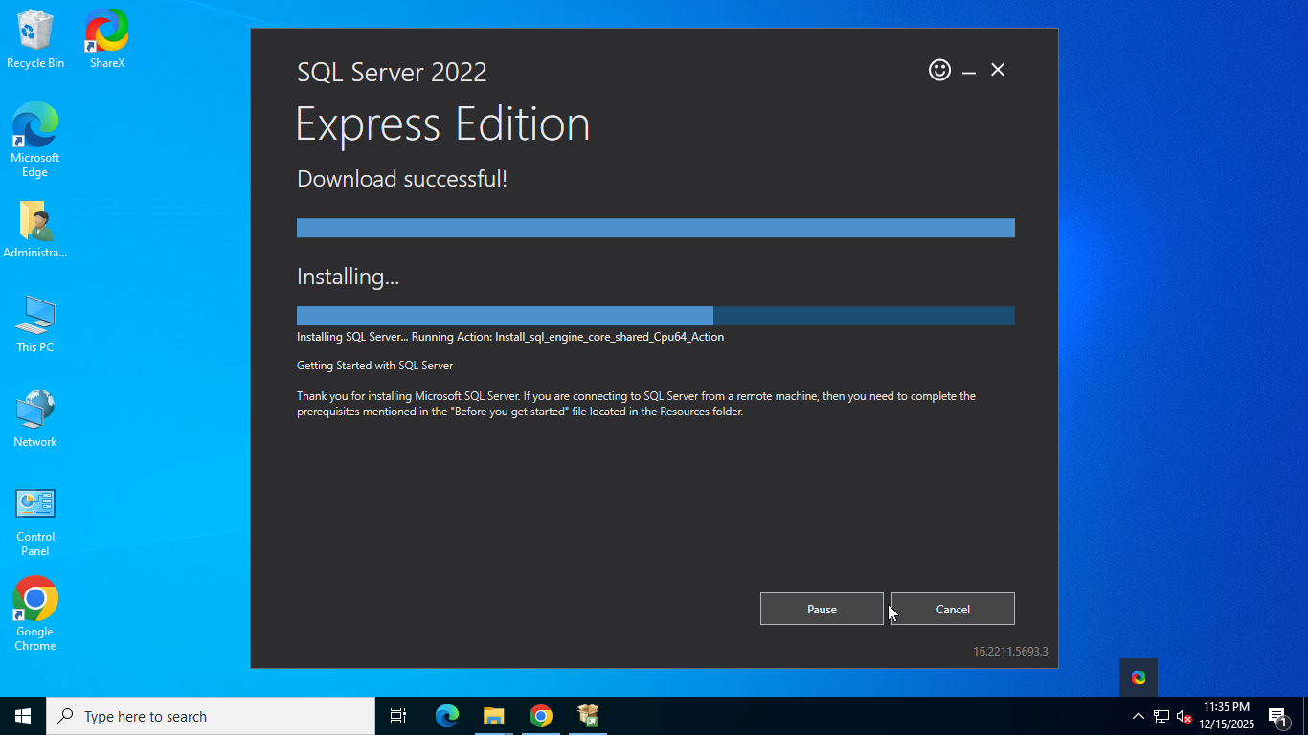
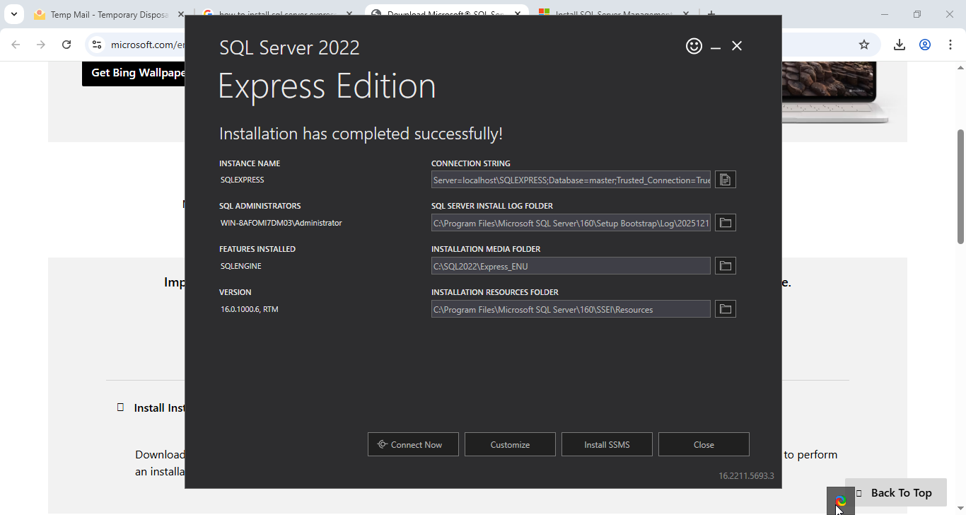
Read the Terms and click on Accept
click Install
Installation in progress
Click on Connect Now

Slide 9
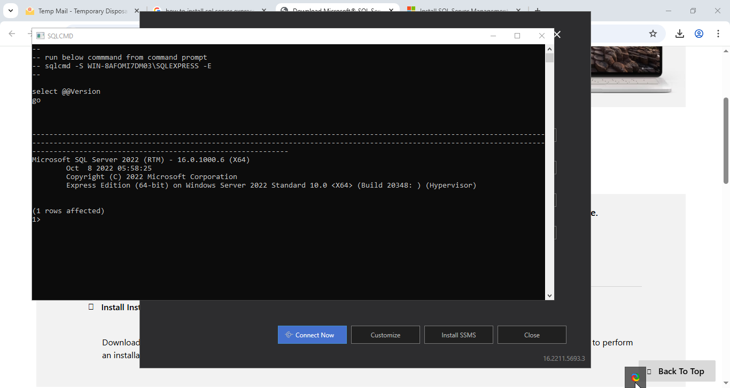
After clicking on Connect Now button if it prints “1 rows affected”
it means the server is installed successfully.

Slide 10
4. Installing SSMS
SQL Server Management Studio or SSMS is a GUI tool. It provides a user-friendly interface to manage SQL Server databases, making tasks like querying, database design, and server management easier through menus and visual tools.
To download SSMS click on this link https://aka.ms/ssmsfullsetup and run the setup.

Slide 11
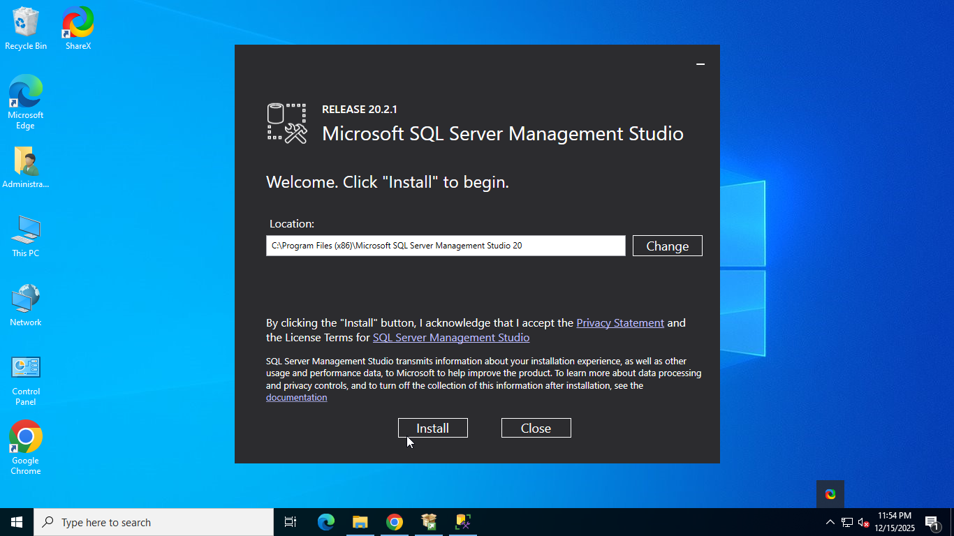
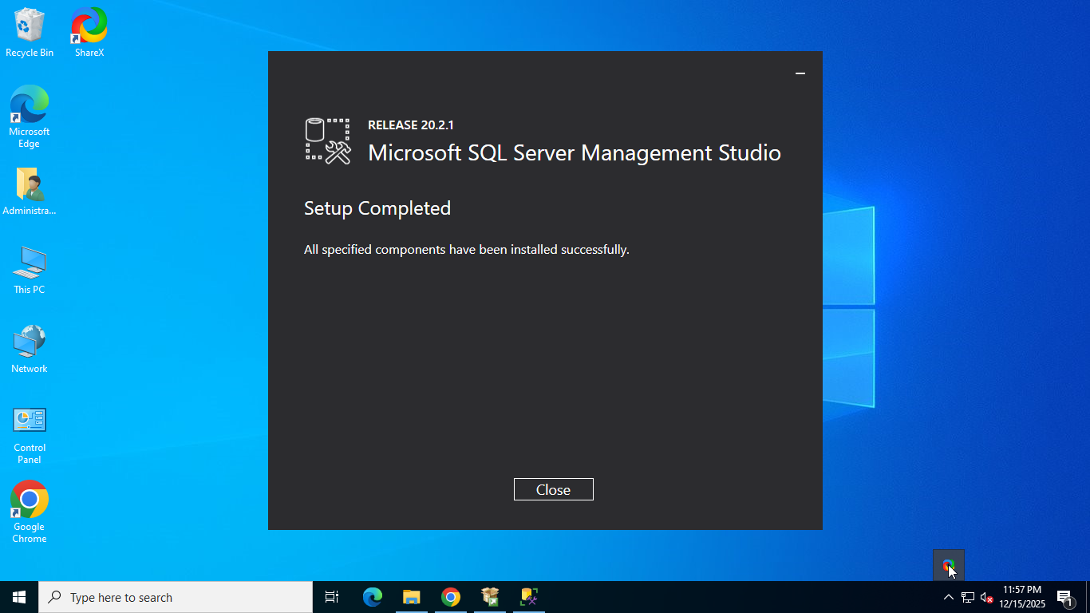
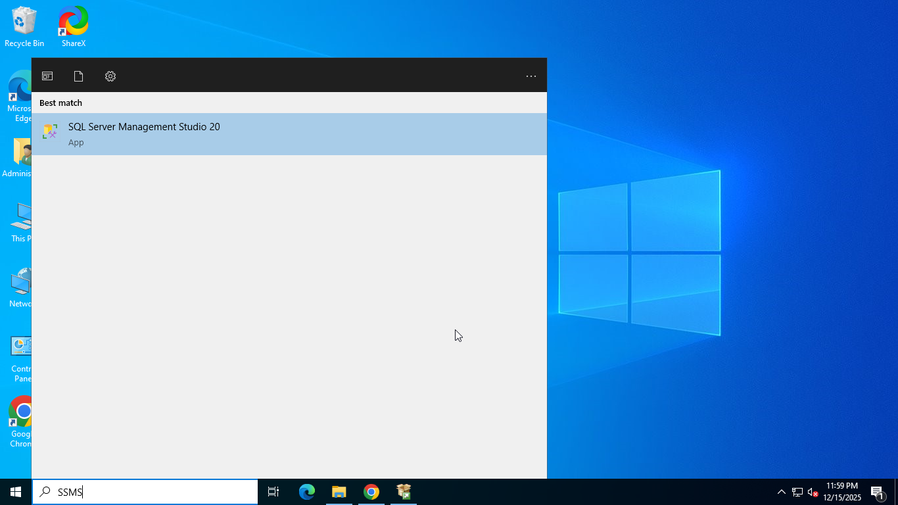
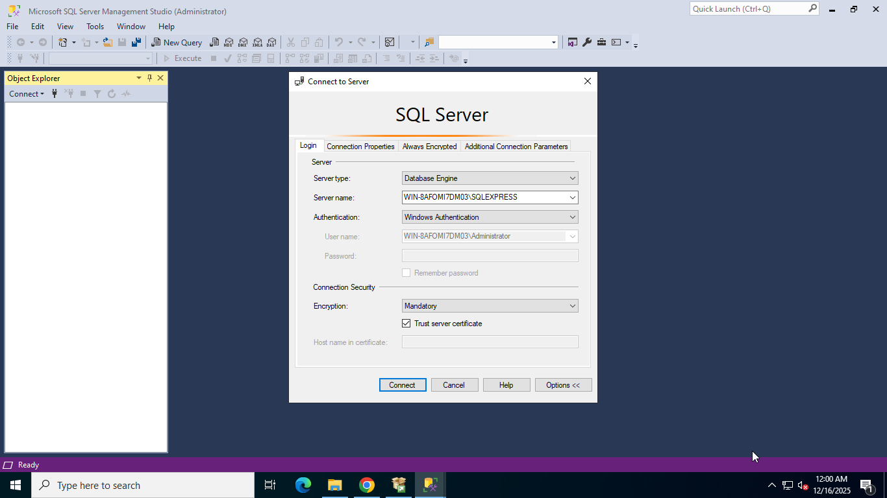
Click on Install
Click on Close
Press Win button and Type SSMS and open
Check Trust Server cert and Click on Connect

Slide 12
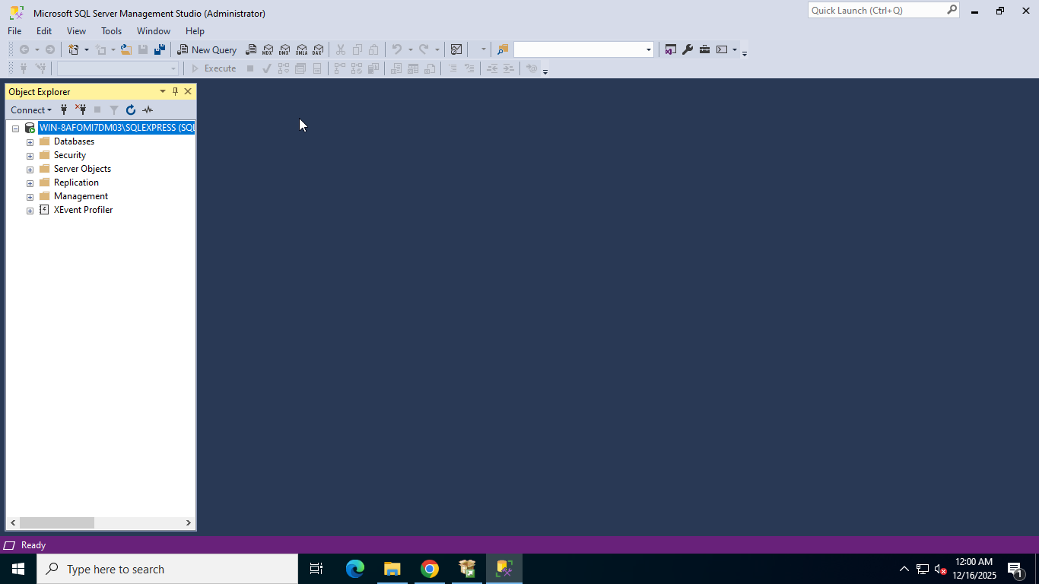
Now our SQL server and SSMS installed successfully

Slide 13
5. Installing Kaspersky Security Center 15.1
Kaspersky Security Center is a unified command center that lets IT administrators manage all the security software for every device in a business from a single location.
To Install KSC open the below in the browser
https://www.kaspersky.com/small-to-medium-business-security/downloads/next-edr-optimum

Slide 14
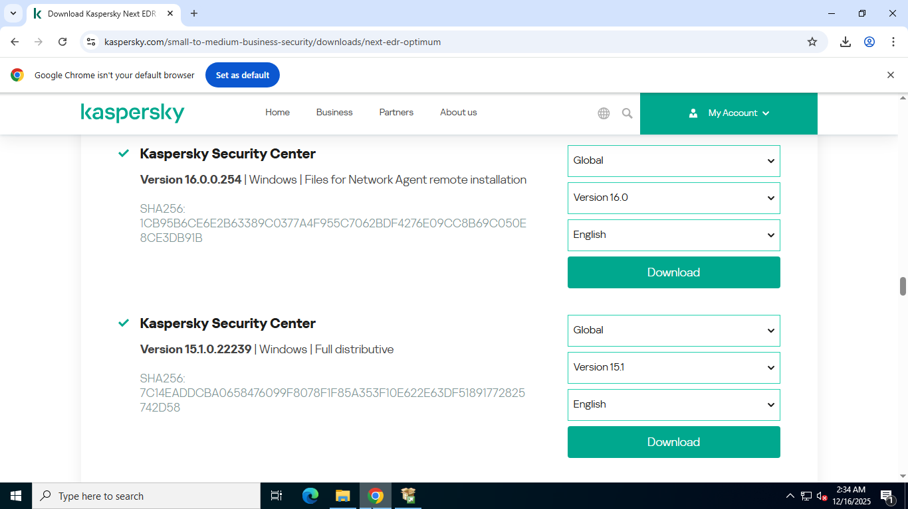
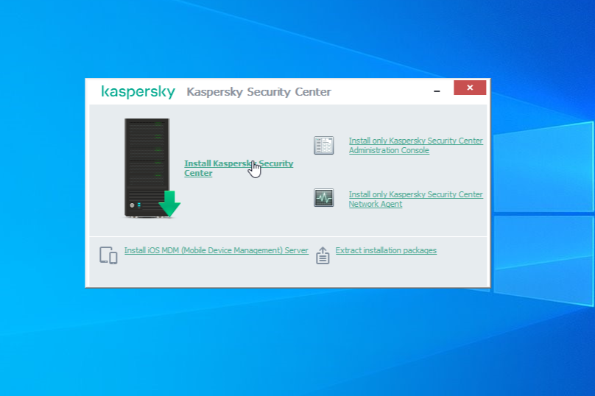
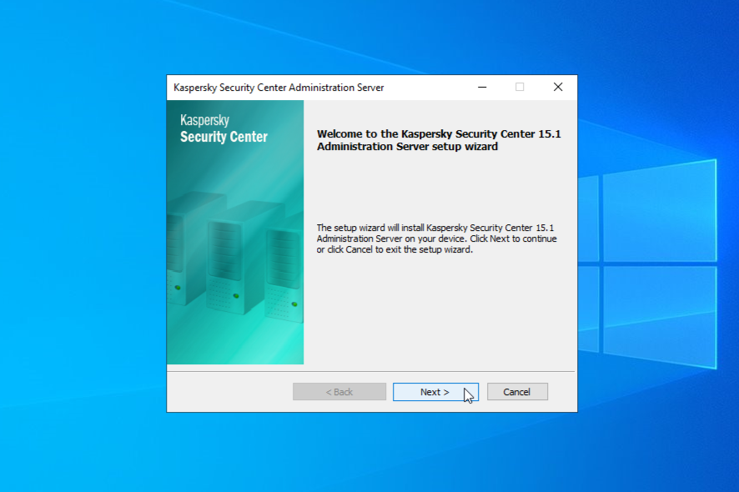
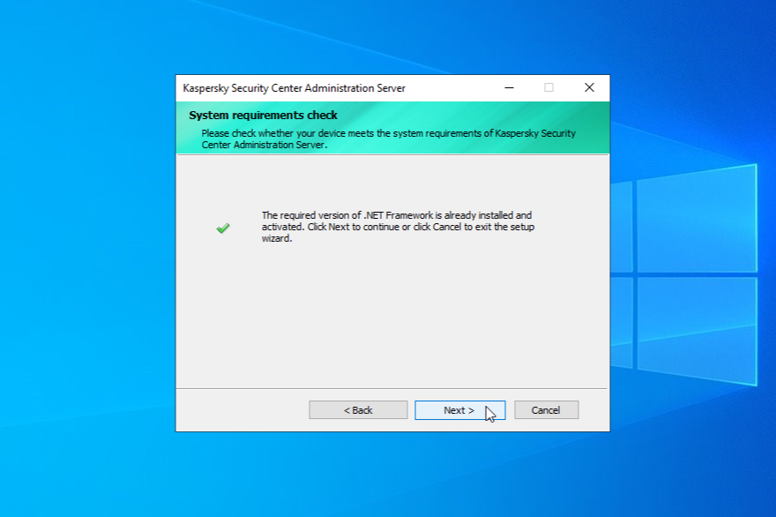
Choose KSC Window distributive and click download
When downloaded run the setup and click on Install KSC
1
2
Click Next
Click Next
3
4

Slide 15
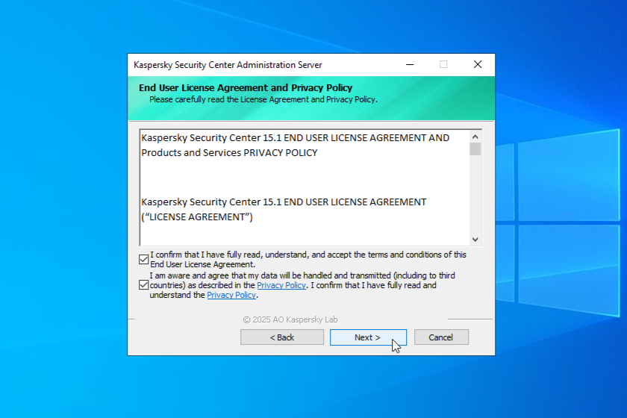
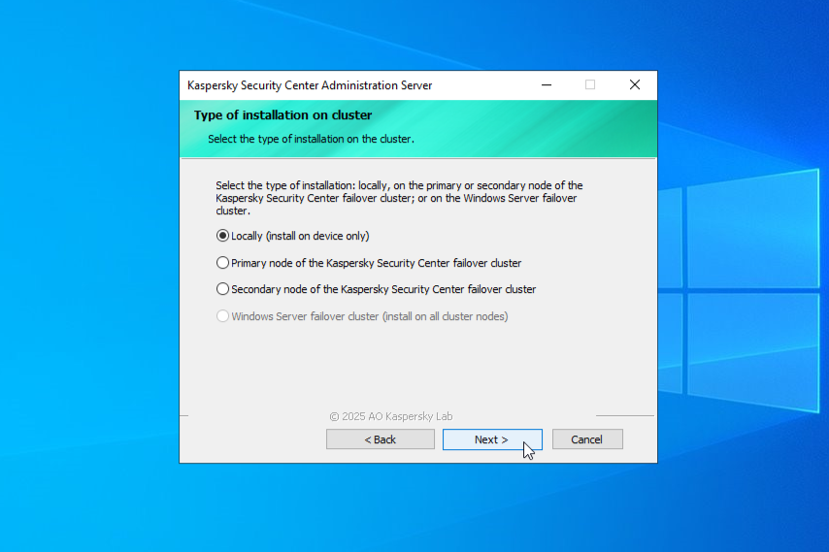
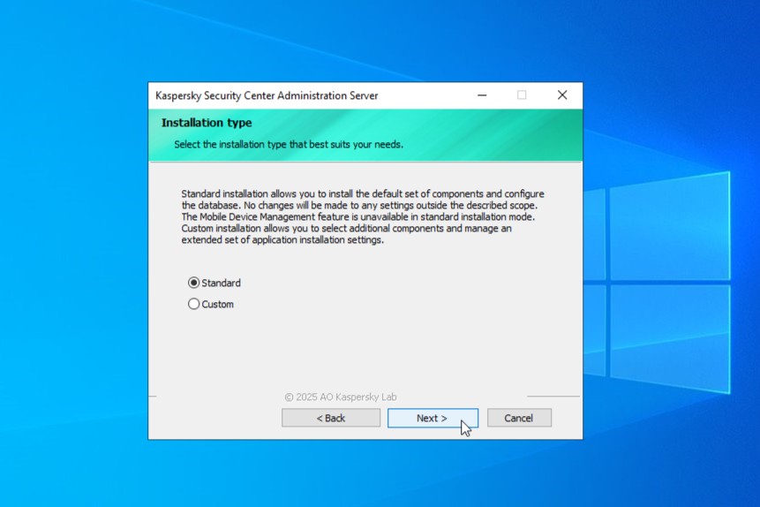
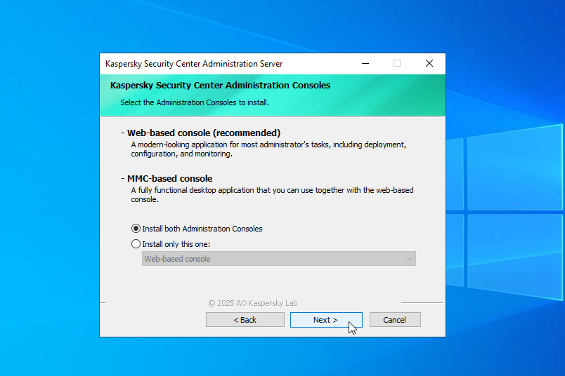
Click Next
Click Next
5
6
Click Next
Click Next
7
8

Slide 16
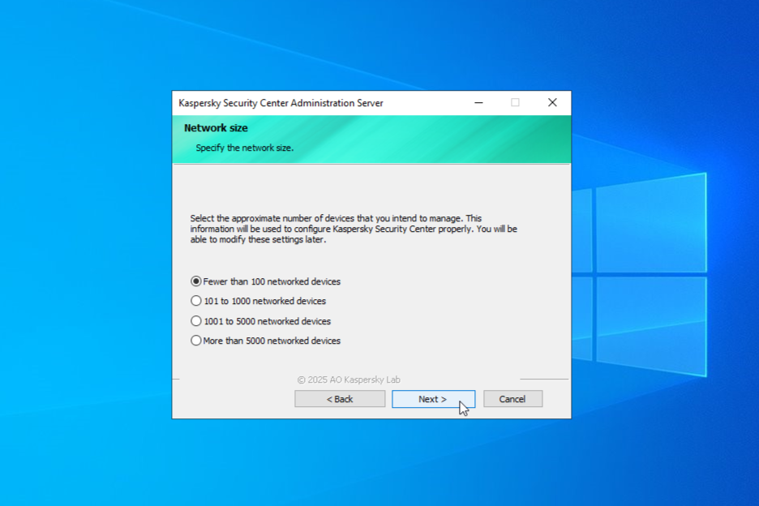
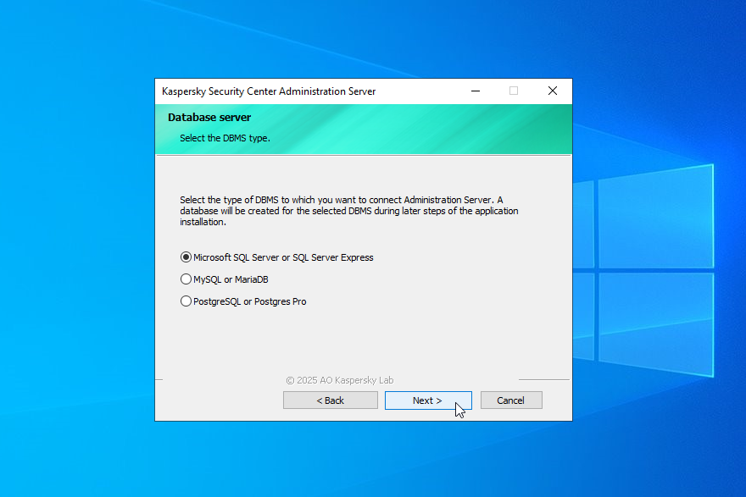
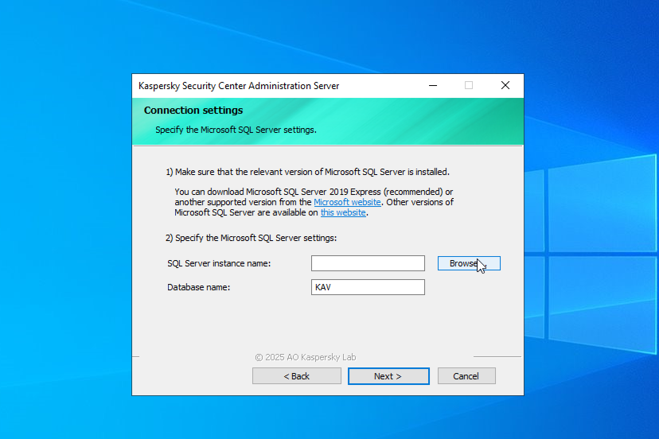
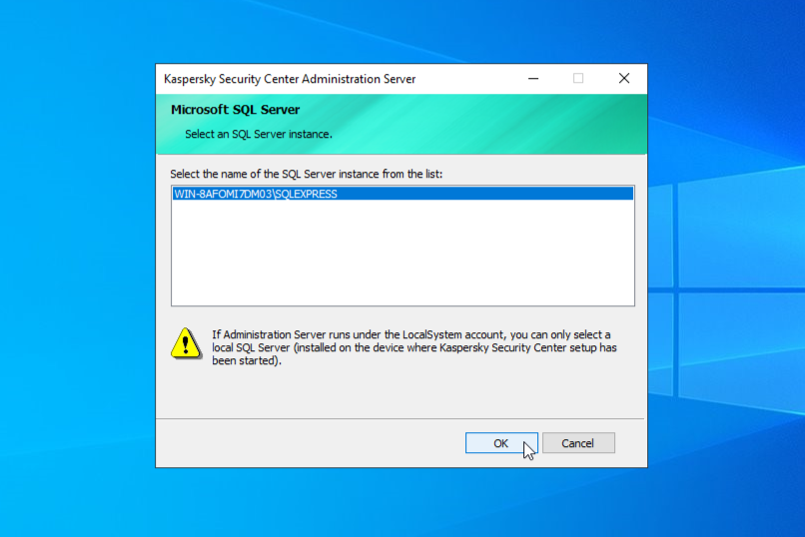
Click Next
Click Next
9
10
Click on Browse button
Choose you SQL db and click OK
11
12

Slide 17
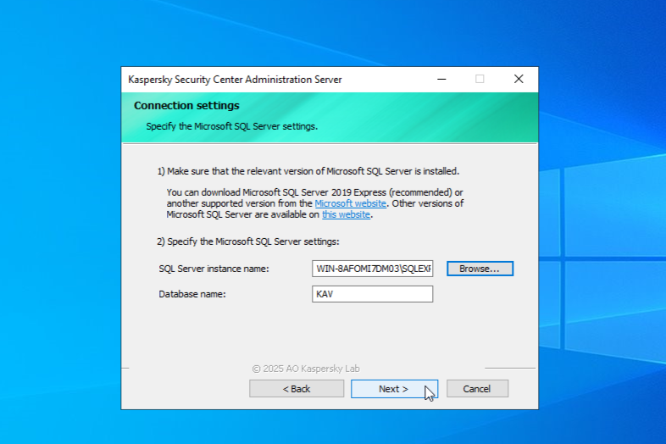
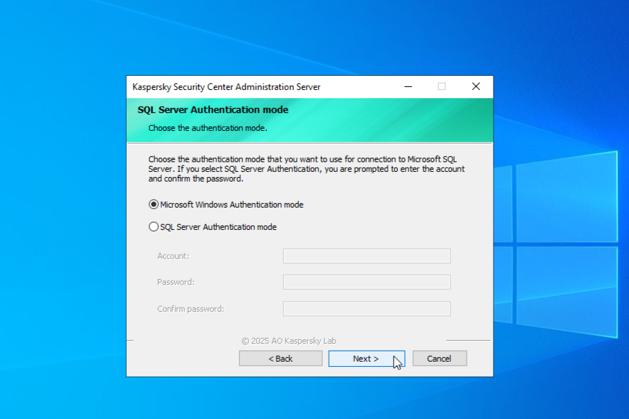
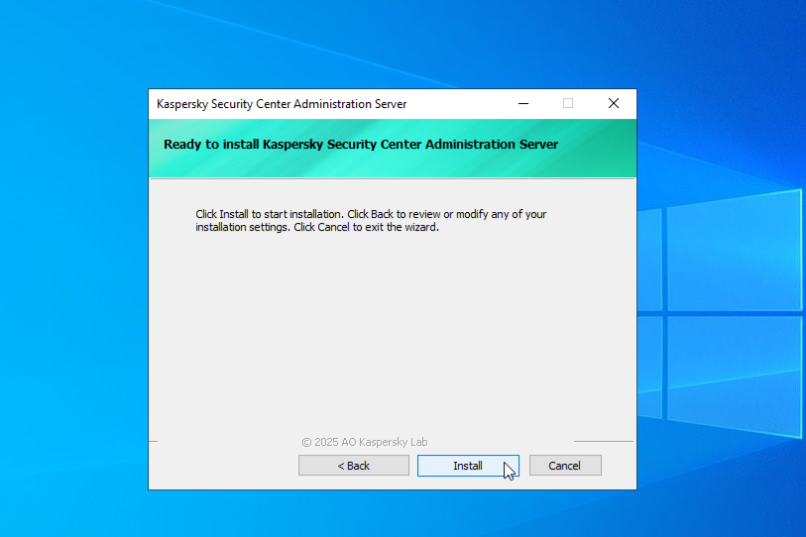
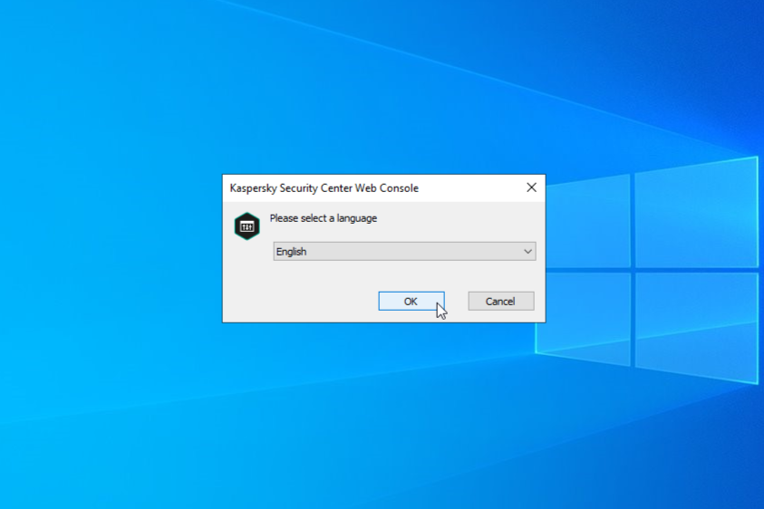
Click Next
Click Next
13
14
Click Next
Choose your language and Click OK
15
16

Slide 18
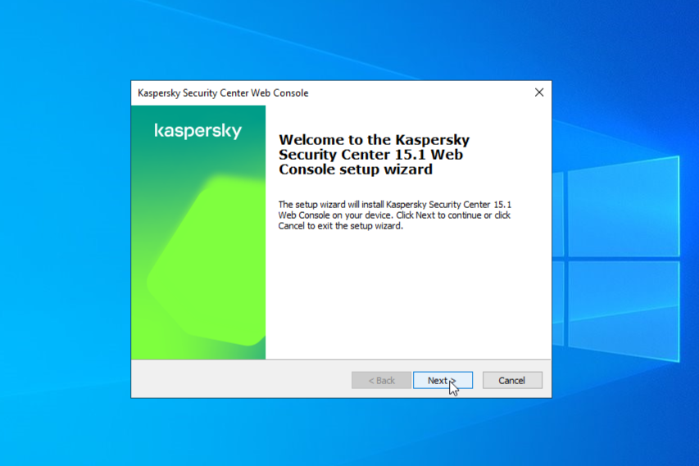
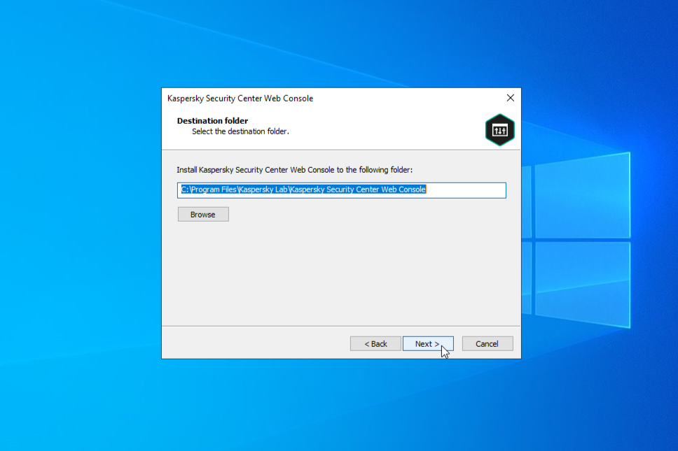
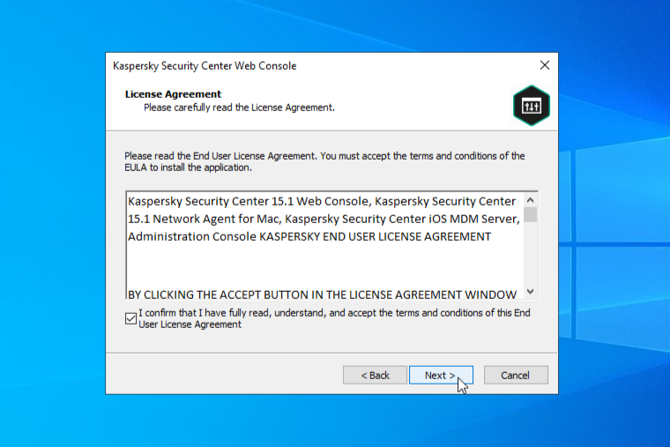
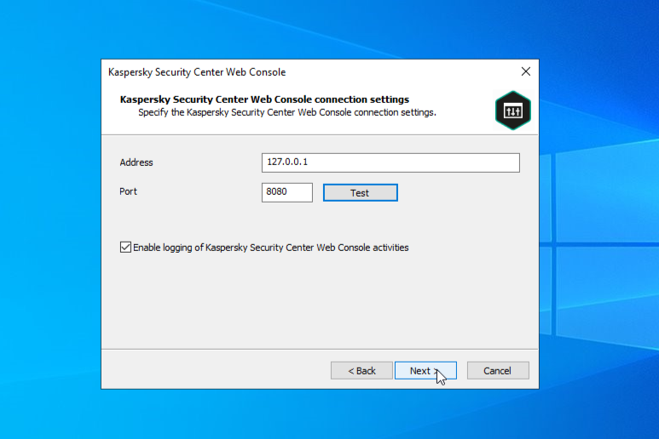
Click Next
Click Next
17
18
Accept the terms and click Next
Keep the loop back IP and click Next
19
20

Slide 19
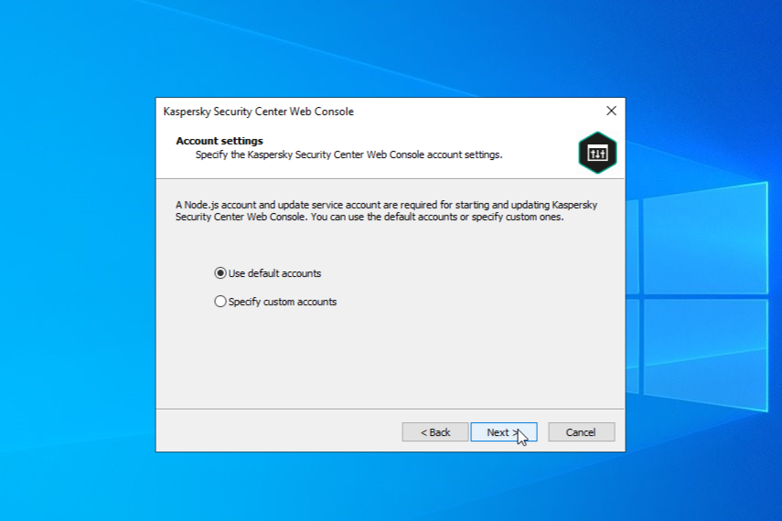
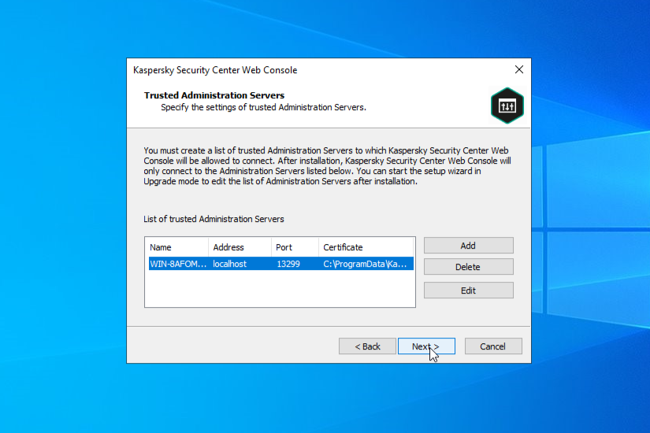
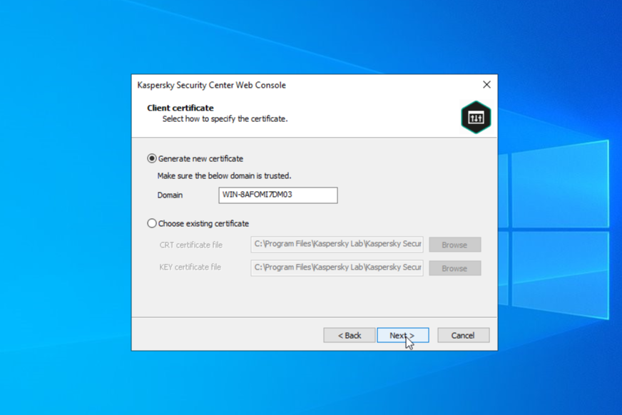
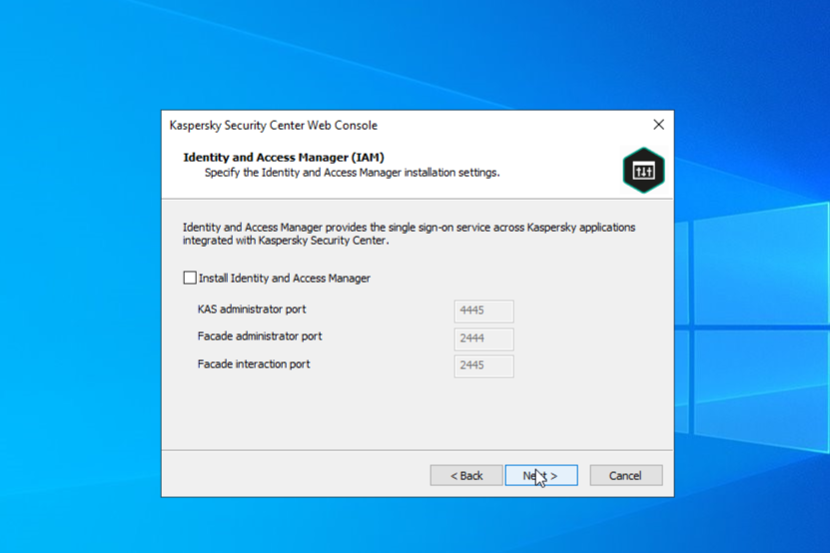
Click Next
Click Next
21
22
Click Next
Don’t check and click Next
23
24

Slide 20
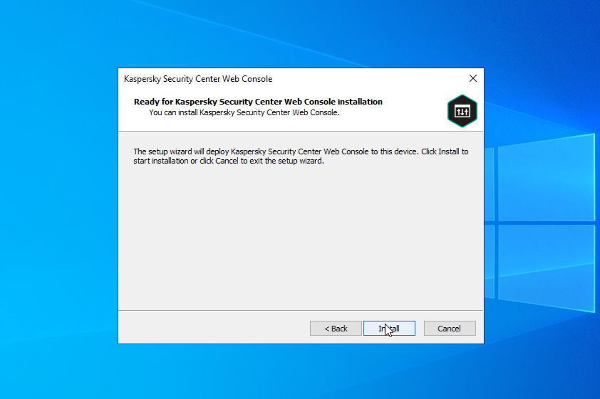
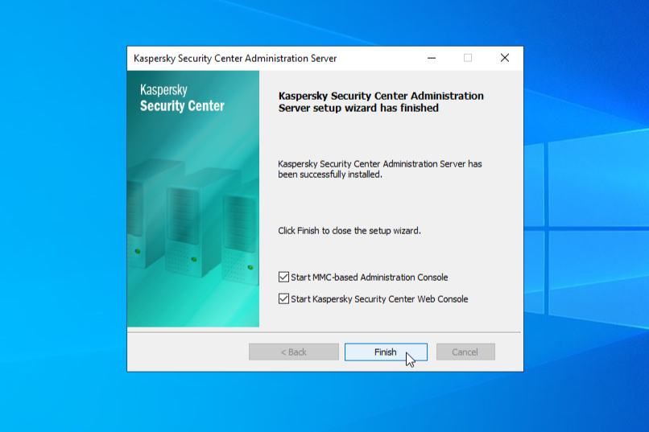
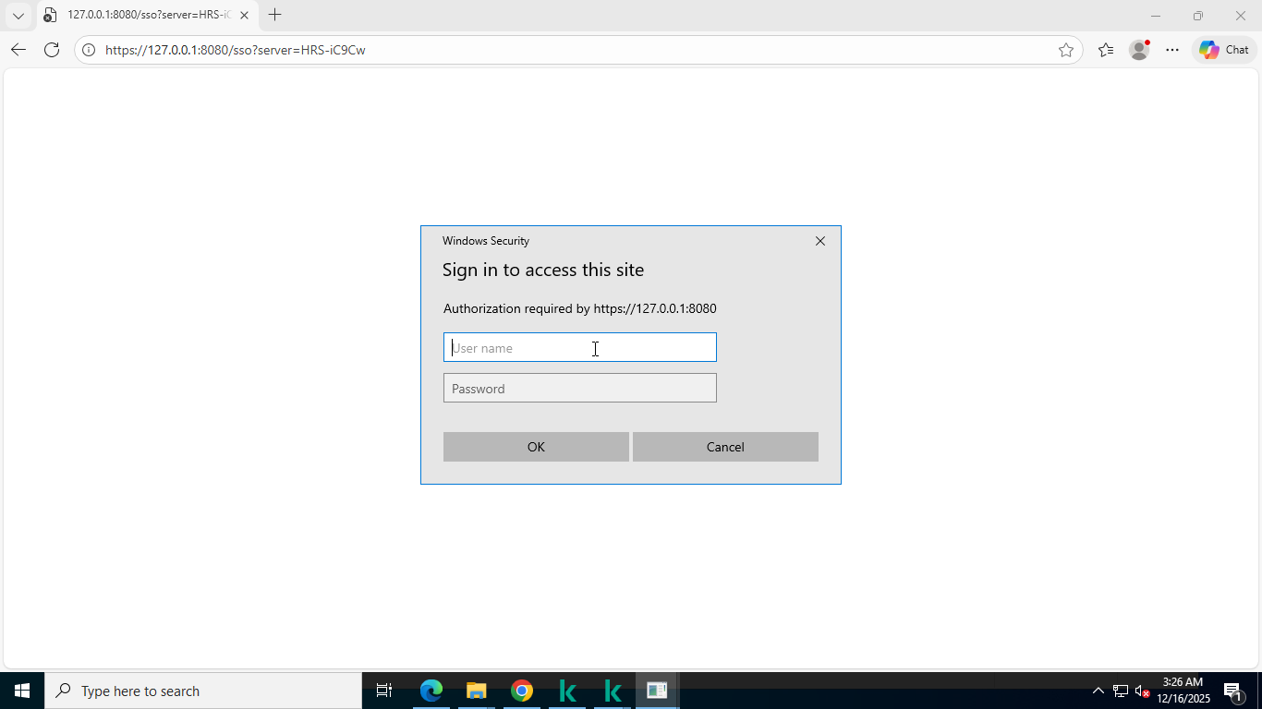
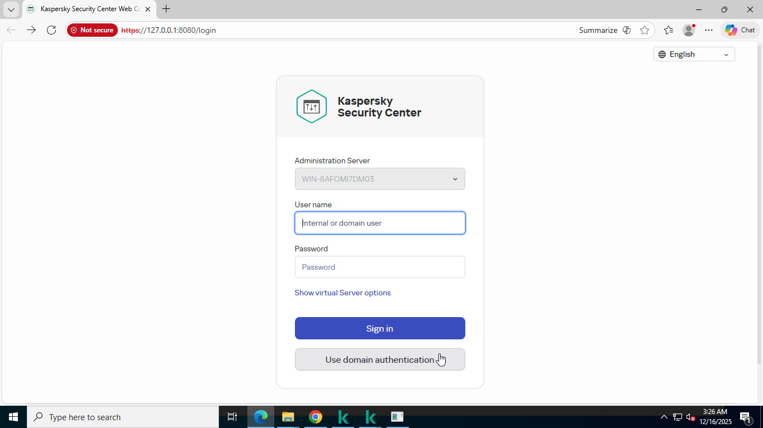
Click Install
Check both box and click Finish
25
26
Choose Use domain authentication
Then enter your domain creds
27
28

Slide 21
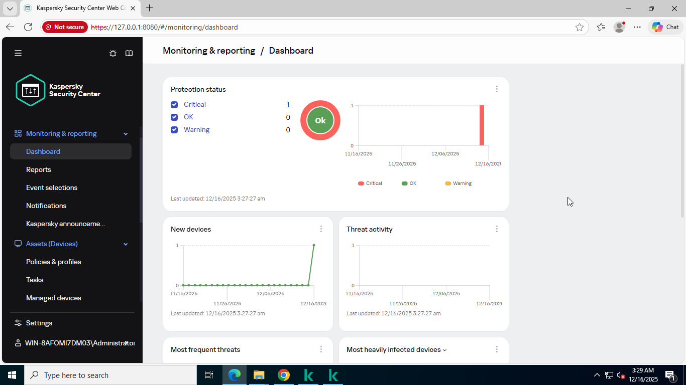
KSC installed successfully, web console

Slide 22
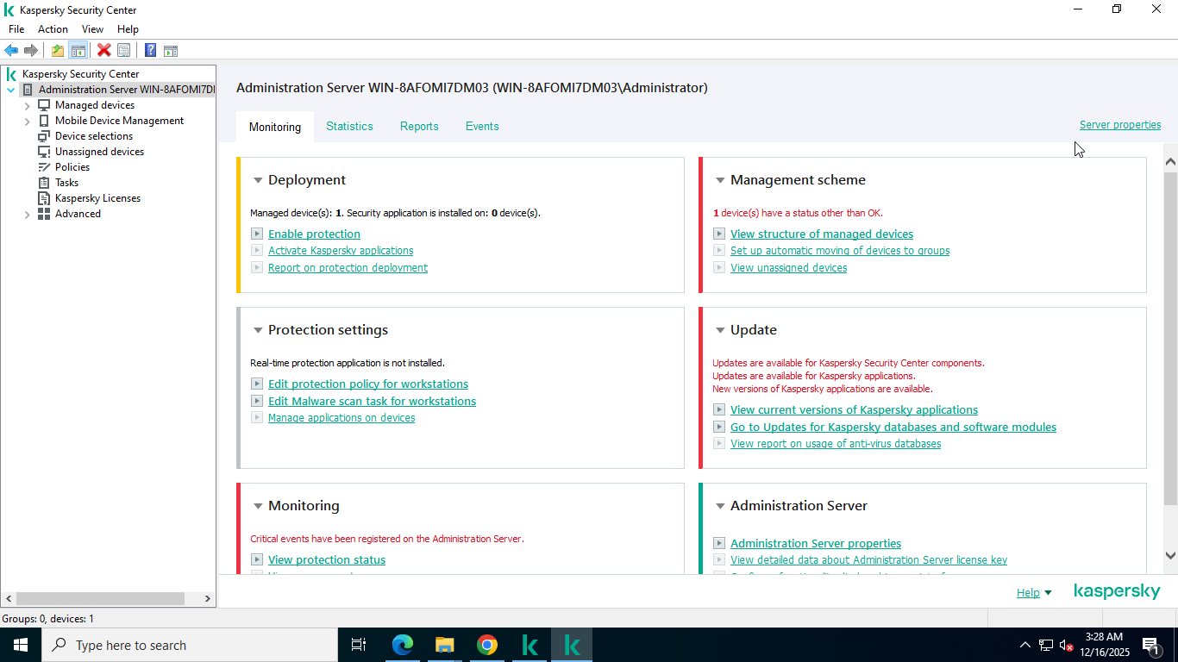
MMC console of KSC

Slide 23
6. Adding Next EDR optimum free trial license key to KSC
Goto tempmailo.com and generate temporary email and copy it.
The visit the following link and fill the form according to your choices.
https://me-en.kaspersky.com/small-to-medium-business-security/downloads/next-edr-optimum-trial
Paste your temporary mail in the form.

Slide 24
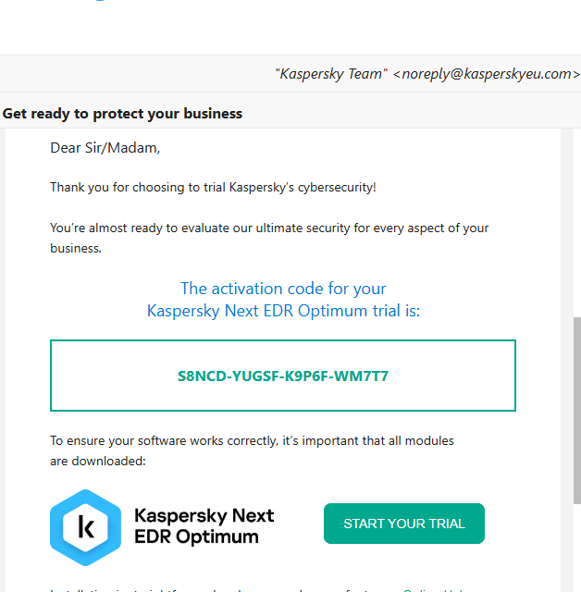
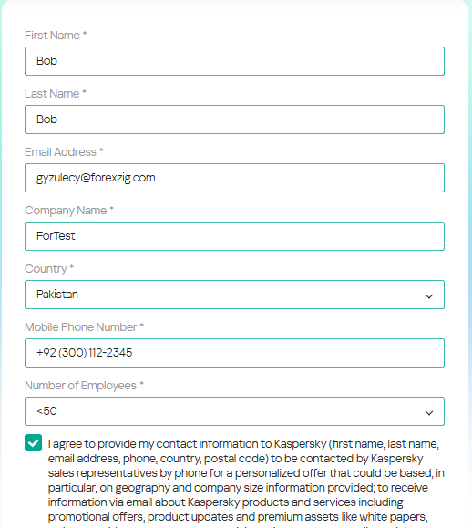
Fill form and Submit
Copy the key from the email

Slide 25
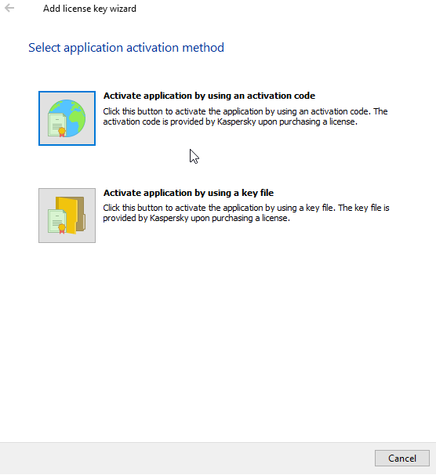
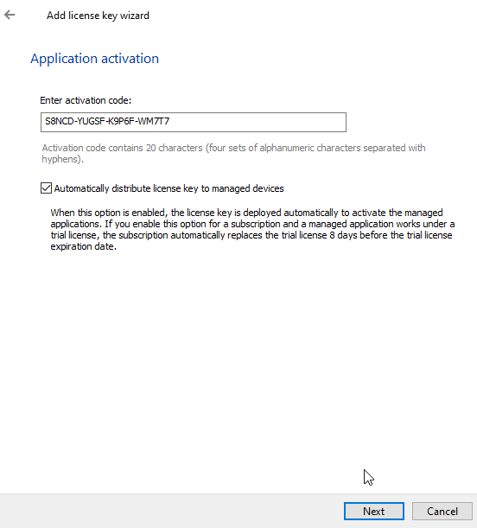
Goto KSC>Licenses>Add>Activation code
Paste your key in the provided box, click Next and Finish

Slide 26
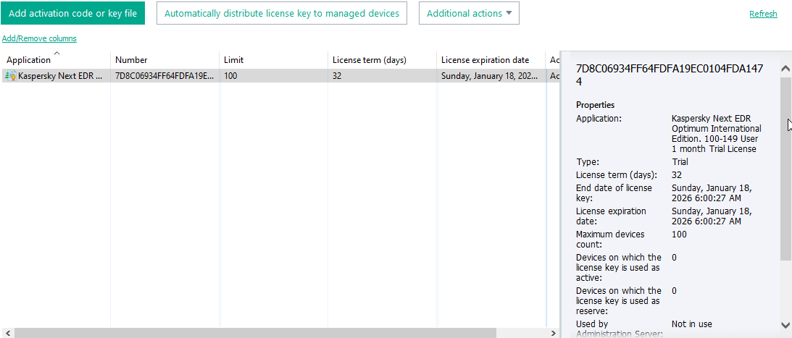
If everything went fine the Next EDR optimum license will start appearing in the KSC>Licenses as shown below.
Note: After adding license, you must update the repo by going to
Advance>Repositories>Updates Kaspersky Database

Slide 27
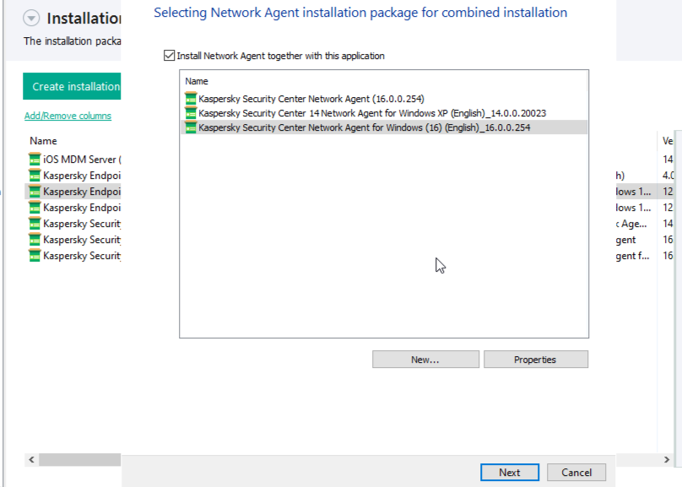

7. Installing Kaspersky network agent on end-point devices
Go to Advanced > Remote installation
Create a standalone package and deliver to the end-point

Slide 28


Run the KSC agent and click on Start Installation
Network agent installed successfully on end-point

Slide 29

After the successful installation end-point devices will start appearing under the
Managed devices

Slide 30
8. KSC 15.1 policies and configuring A policy is a set of Kaspersky Endpoint Security settings that are applied to all client devices included in the administration group.
Police Name | Description | Recommended settings
File Threat Protection | Scans files when they are opened, created, executed and blocks malware before it can run | Scan all files
Mail Threat Protection | Scans incoming and outgoing emails Protects against malicious attachments and phishing | Incoming and outgoing messages
Web Threat Protection | Blocks malicious websites | Block known phishing & malware URLs
Firewall Configuration | Controls network traffic (inbound & outbound) | Enable Firewall
Exploit Prevention | Protects applications from exploit techniques | Block
Behavior Detection | Detects suspicious behavior instead of signatures such as ransomware | Delete
Remediation Engine | Rolls back damage caused by malware | Enable
Web Control | Controls user access to website categories | Depends on your choice

Slide 31

Verifying polices on endpoint devices

Slide 32
Thank you for your time!

